Slide 1















Slide 2

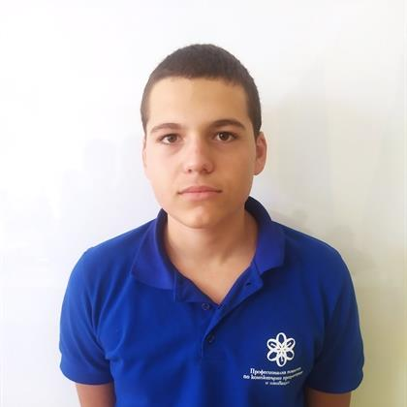
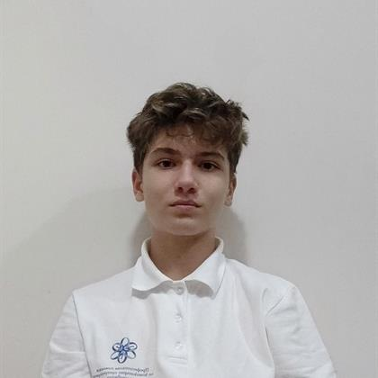
Our team
Todor Atanasov
Aleks Kazakov
Front-end developer
Back-end developer

Slide 3



The plan!

Slide 4
Business plan
Implement, oversee and administer the use of solar panels in hospitals
Receive a percentage stake in the project
A renewable , environmentally friendly energy solution
Cost-effective solar power beneficial for all
Research and analysis on the best course of action to make sure the project succeeds
Adapt to any possible competition and stay informed on government laws
Get potential investors interested in the project

Slide 5







Technology stack

Slide 6
Let’s jump to the code!

